Slide 1
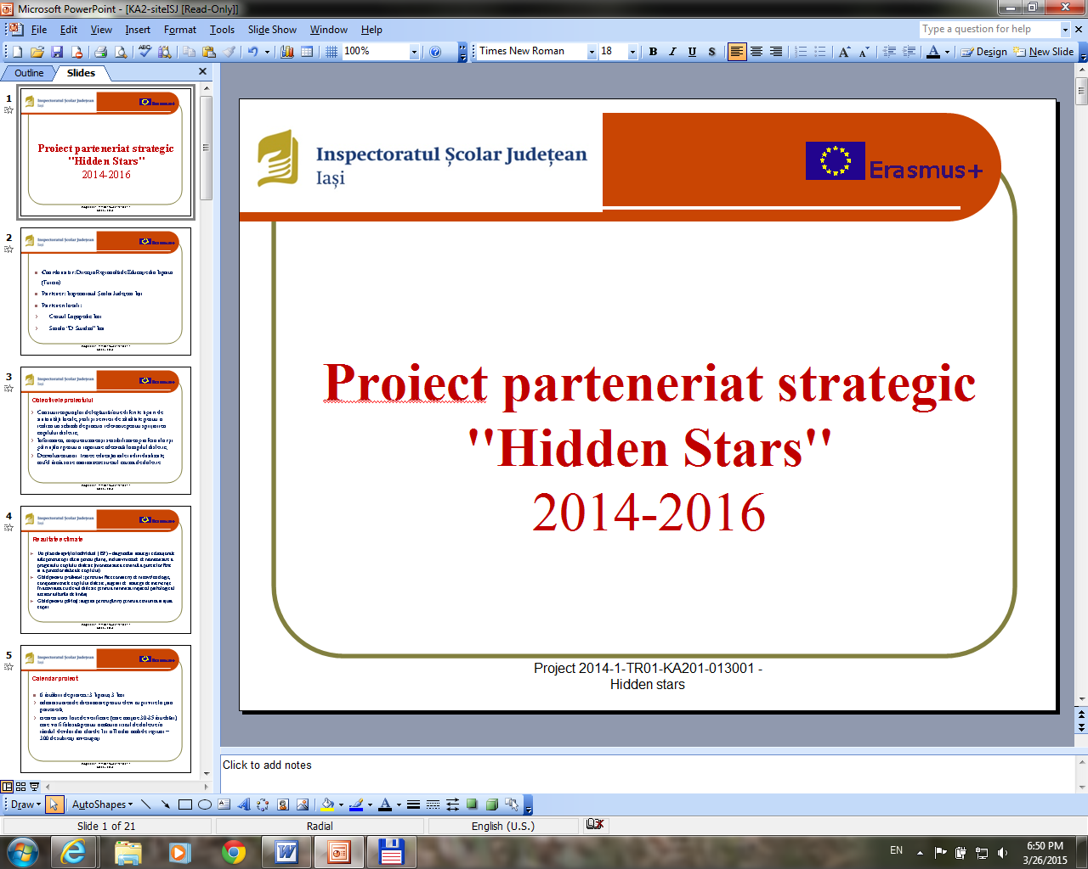

Essential life skills training modules for dyslexics
THEORETICAL AND PRACTICAL GUIDELINES ON THE EDUCATIONAL INTERVENTION FOR THE DYSLEXIC CHILD

Slide 2
CONTENTS
Dyslexia – general information
Basic academic abilities
Social Life Skills
Basic psychomotor skills
Family and Teacher Support System
Lesson plans
Appendix
Bibliography

Slide 3
Learning difficulties
disorders manifested
in
the acquisition and use of listening, speaking, reading, writing, reasoning, mathematical skills and social competence
a dysfunction of the central nervous system
due to

Slide 4
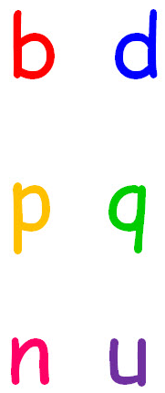

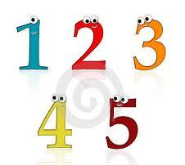
Learning difficulties
affect children
with normal cognitive abilities but who experience specific
academic-related difficulties (reading, writing, mathematical skills)
are not explained
by lack of exercise or motivation,
by emotional factors or inadequate educational intervention.

Slide 5
Basic academic abilities
Lexical acquisition
Dyslexia as a lexical acquisition disorder
Writing acquisition
Dysgraphia as a writing acquisition disorder
Mathematical calculus
Dyscalculia as a mathematical disability

Slide 6
Dyslexia
a learning difficulty manifested by problems in
learning foreign languages
comprehending
basic instructions
Pronunciation difficulties;
Verbalize unfamiliar words
Reading below the age standard
establishing the normal sequence of things
perceiving the similarities and differences between letters / words
perceiving the similarities and differences between letters / words

Slide 7
E luna . Găinuşa harnică are acum nouă puişori. Unul are guleraş roşcat. Altul are gâtul golaş.Cum se lasă seara, găinuşa îşi bagă puii în casă. Vulpea e şireată. Ea dă târcoale casei.
Words are seen as compact black spots
martie

Slide 8
Aseară am fost cu Georgia la un spectacol de magie. Marele magician Gino a făcut câteva magii grozave: a transformat portocalele în fragi, turta dulce în covrigi şi cățelul în iepuraş gingaş. Publicul gălăgios a aplaudat fiecare magie.
A fost o seară magică!
Word are seen as colourful spots

Slide 9
Background of the text
changes colour

Slide 10
or
– change -look like they are moving in ferent places on the page – creating
letters
words
position
dif
confusion

Slide 11
CONFUSION
left – right, up - down
bun
dun
dnu
pun
bnu
pnu
b
i
l
d
i
s
e
x
a
s
e
a

Slide 12
The specific of dyslexia on age levels
Pre-primary school students | difficulty with word pronunciation, vocabulary acquisition, fine motor skills (tying shoelaces, buttoning clothes, using writing tools), with following the logical sequence of events in a story.
Primary school students | difficulties in establish the connection between letters and sounds, in learning the alphabet and the multiplication table, in spelling and reading (letter inversion in words, confusions between similar letters / numbers).
Middle school students | have difficulty in learning / identifying prefixes / suffixes, word roots, in word spelling and composition writing, in narrating events chronologically
High school / college students | have difficulty in reading and writing, in learning a foreign language, in memorizing and understanding instructions, in writing reports and unstructured essays
Adults | struggle with reading and spelling a significant number of words, with task and time planning

Slide 13
Dysgraphia as a disorder in the acquisition of writing
Discrimination disorders and confusions between vowels and consonants
Separation of words into syllables
Syllables omissions – usually of final syllables;
Prepositions and conjunctions omission
Motric disgraphy
Mirror writing
Omissions and substitution of graphemes
Omission of final graphemes
Words omission
The succession of the graphemes
Reversal of graphemes;

Slide 14
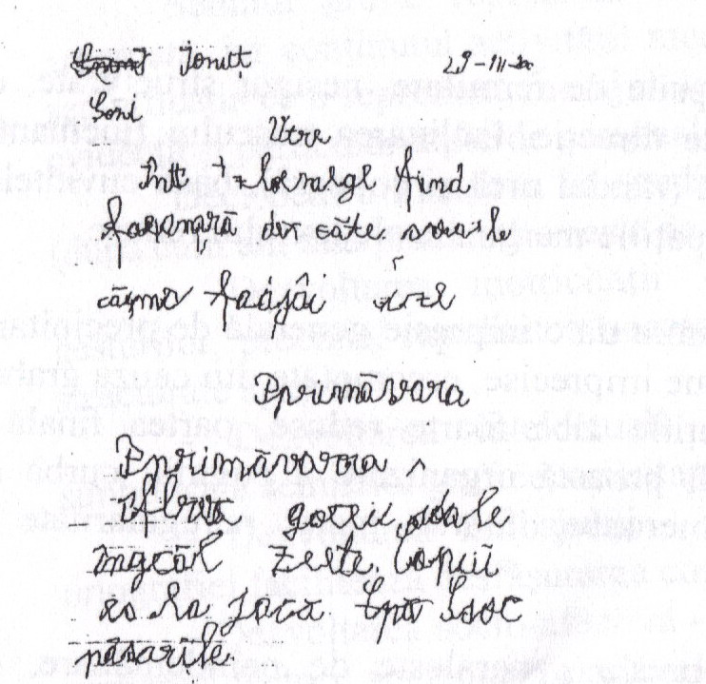

Slide 15
Dyscalculia - disorder in the acquisition of mathematical notions
is the correspondent of dyslexia in mathematics, affecting the capacity of understanding the number concept
the child suffering from dyscalculia is able to prove a normal level of intelligence or even a level above normal
consists in weak results only as far as mathematics is concerned, without affecting the cognitive functioning.
cannot integrate numbers and their symbols, from the cognitive point of view.

Slide 16
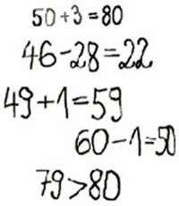

Slide 17
Psychomotricity
It is about the global approach of a person,
where
interactions between motricity (tonus, posture, movements etc.) and psychic (emotions, imagination, intention etc.) are constant.

Slide 18
basic motric behaviours
Oculomotor coordination -
neurologic and motor behaviours
muscular tonus
motor-perceptive behaviours
disorders of body scheme
laterality
orientation, organization and spatial structuring
orientation and temporal structuring
Static equilibrium,
Dynamic equilibrium,
interrupted writing,
incorrectly designed letters ,
diverse dystonia and syncinesy)
(hypertonia, paratonia,
Psychomotor
disorders

Slide 19
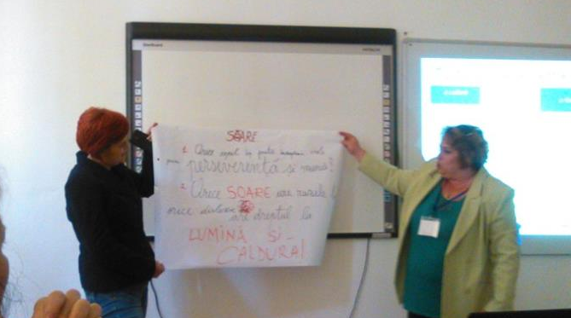
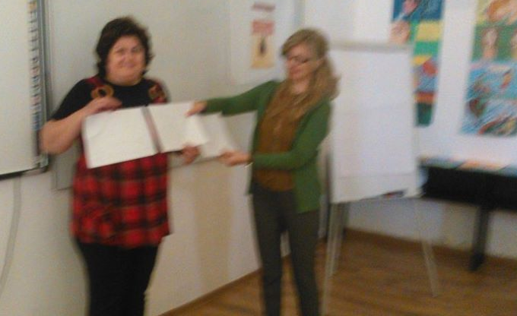
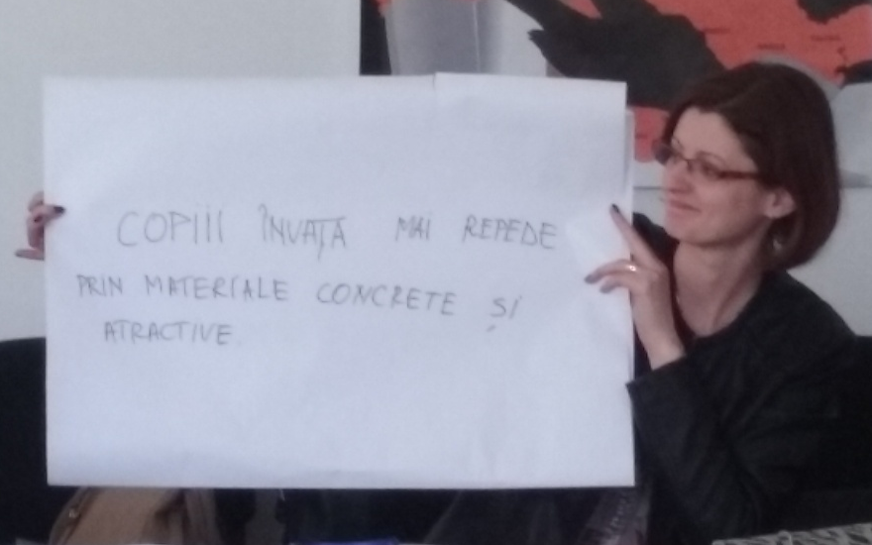
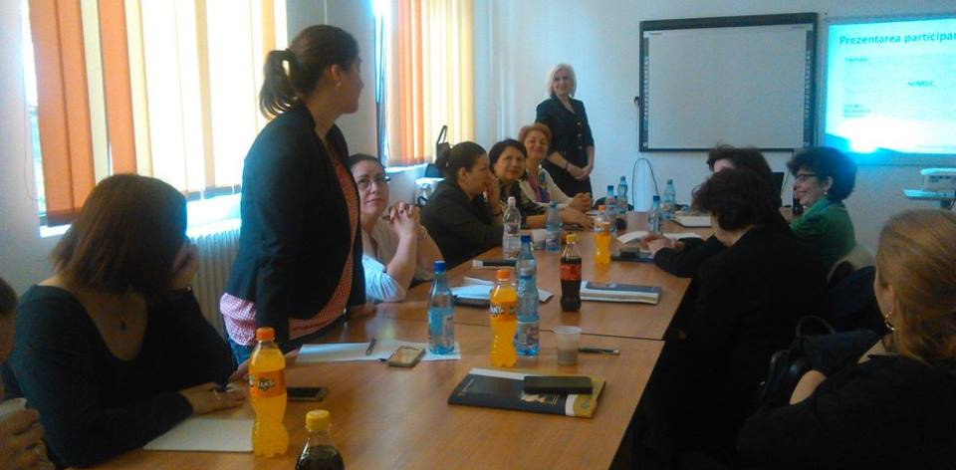
Training module

Slide 20
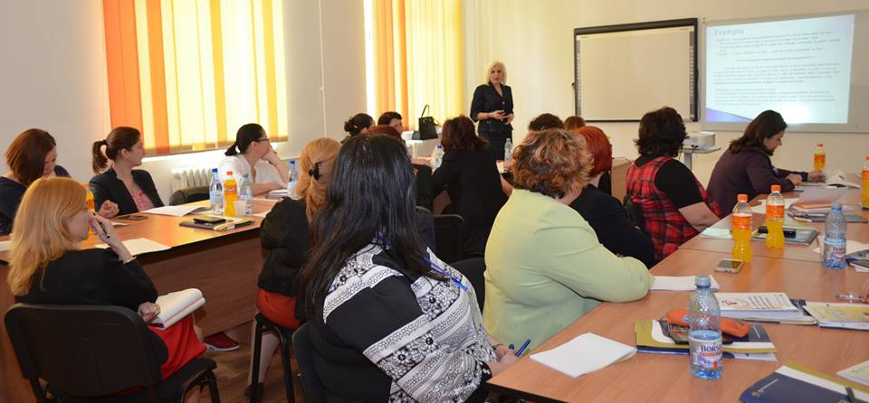
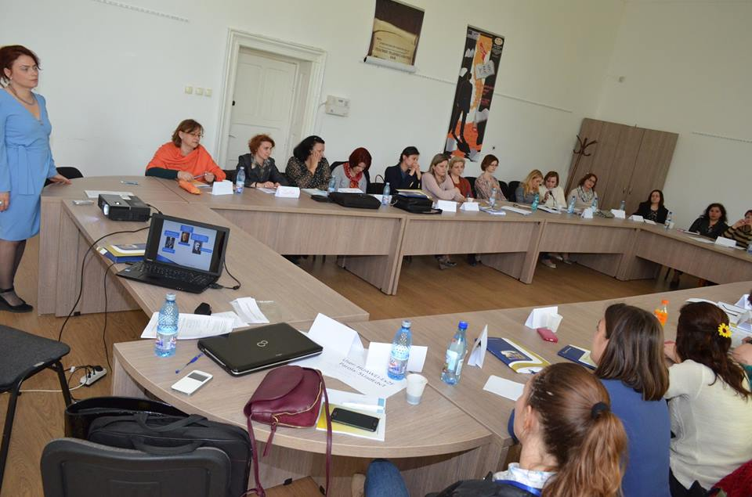
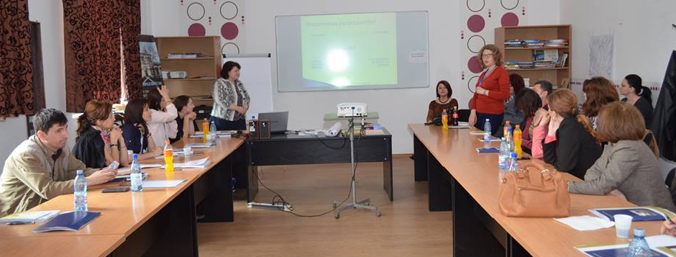

Slide 21
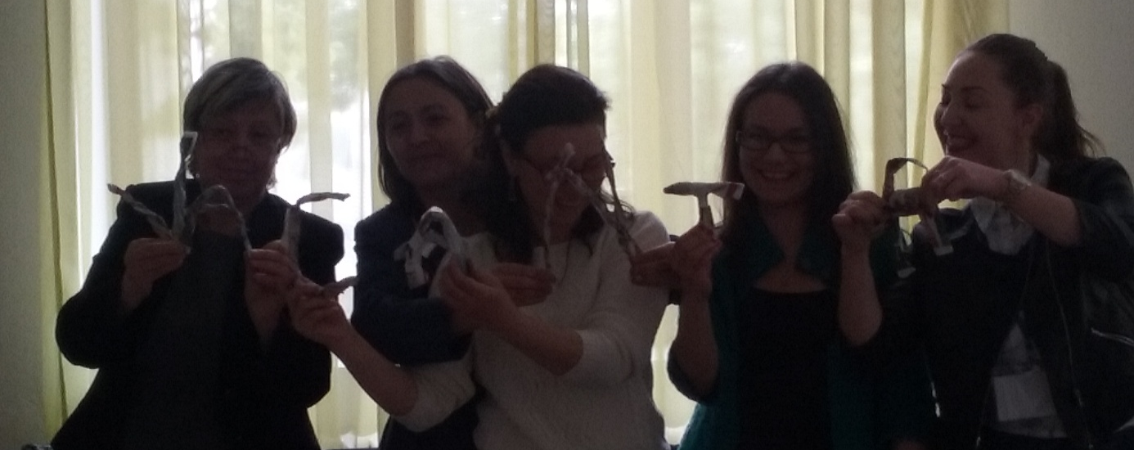
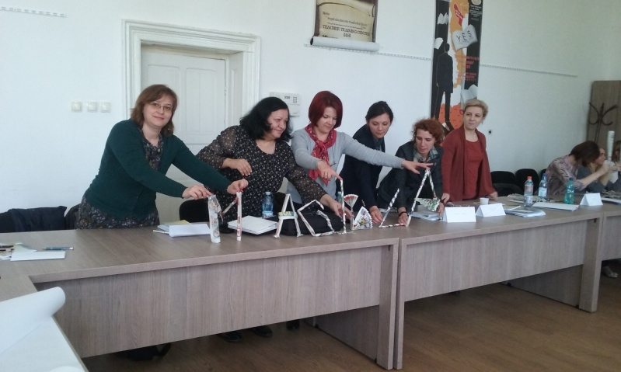
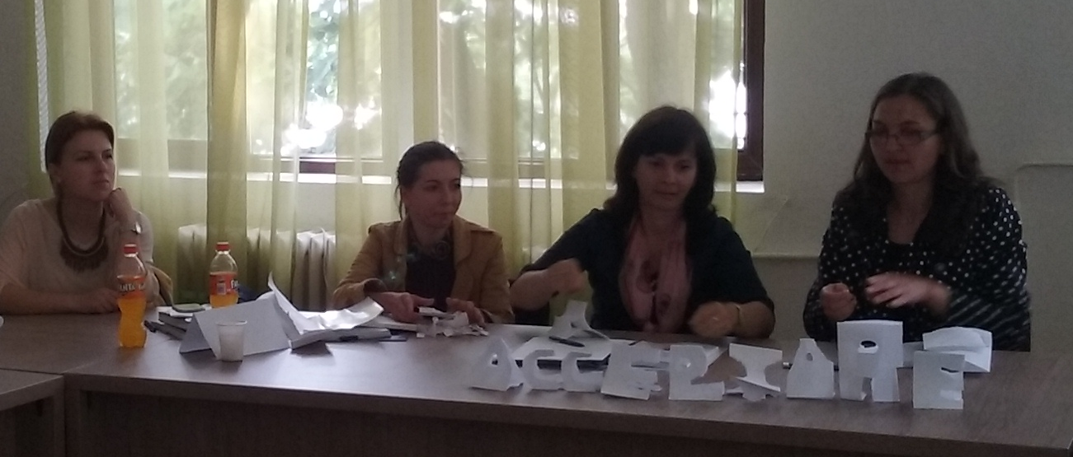
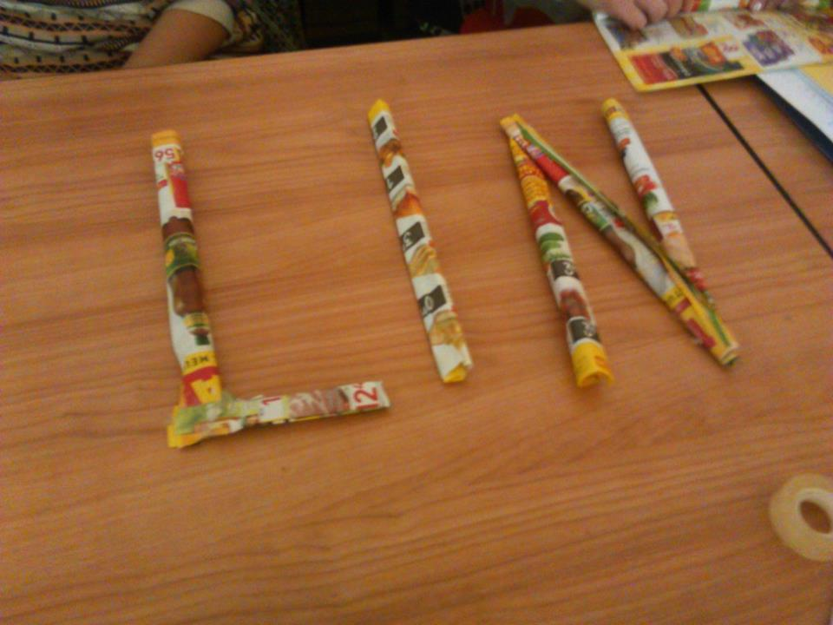
Training module

Slide 22
Social Life Skills
Notes for Teachers
Emphatic Skills Activities
Self-Awareness Activities
Controlling the Emotions Activities
Decision Making Activities
Coping With Stress Activities
Communication Skills Activities
Group Work and Cooperation Activities
Conflict Resolution/ Problem Solving Activities

Slide 23
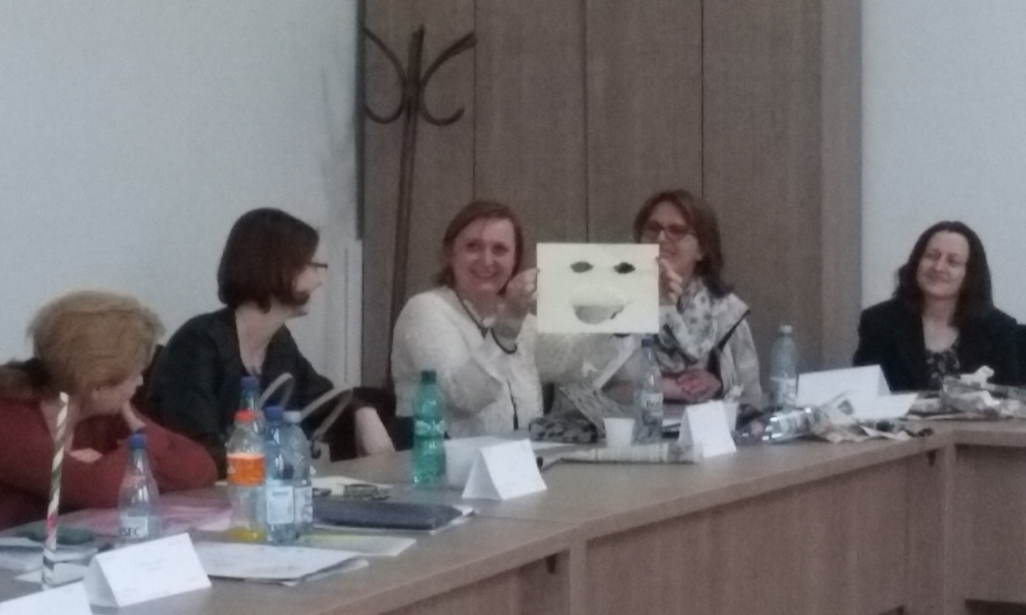
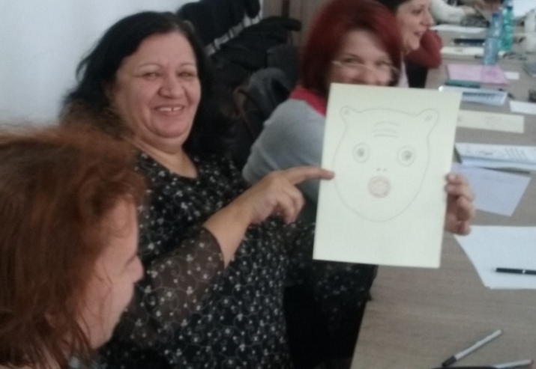
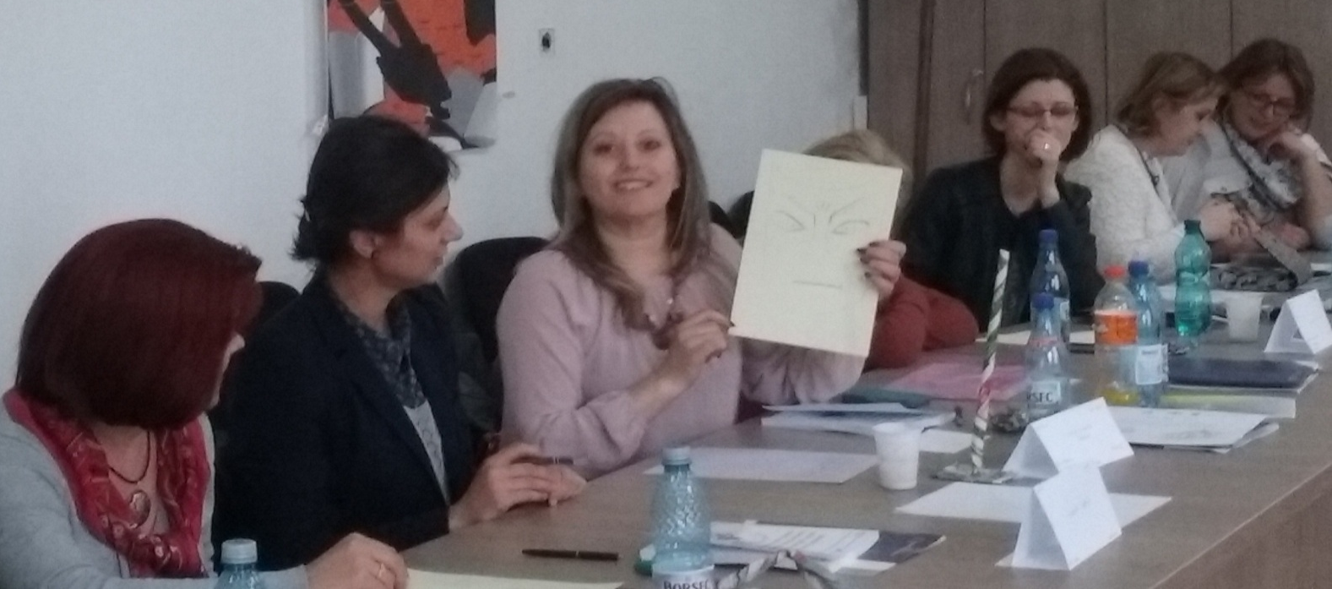
Training module

Slide 24
Family and Teacher Support System
The Educational Programme about Informing
Parents on the Developmental Periods of Children
The Educational Programme to Improve Problem
Solving Skills of Parents
Information Notes-Four Common Family Types
Basic Needs Of the Family
Common Attitudes of Parents

Slide 25
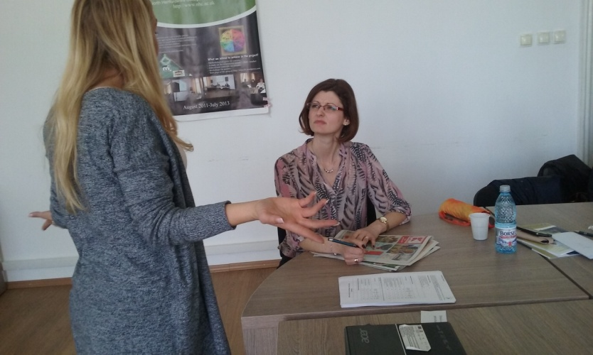
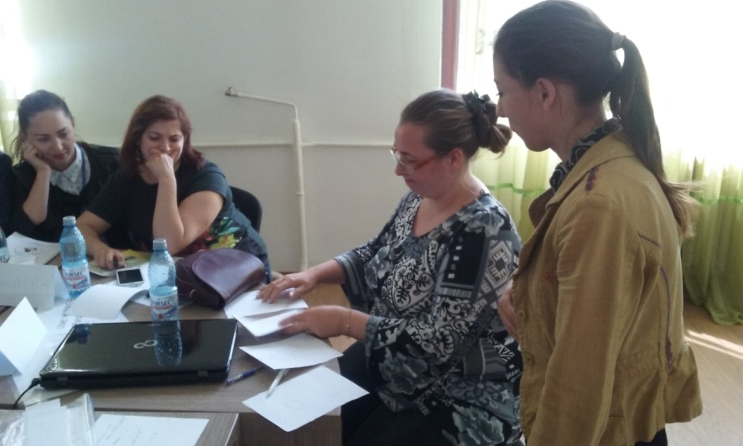
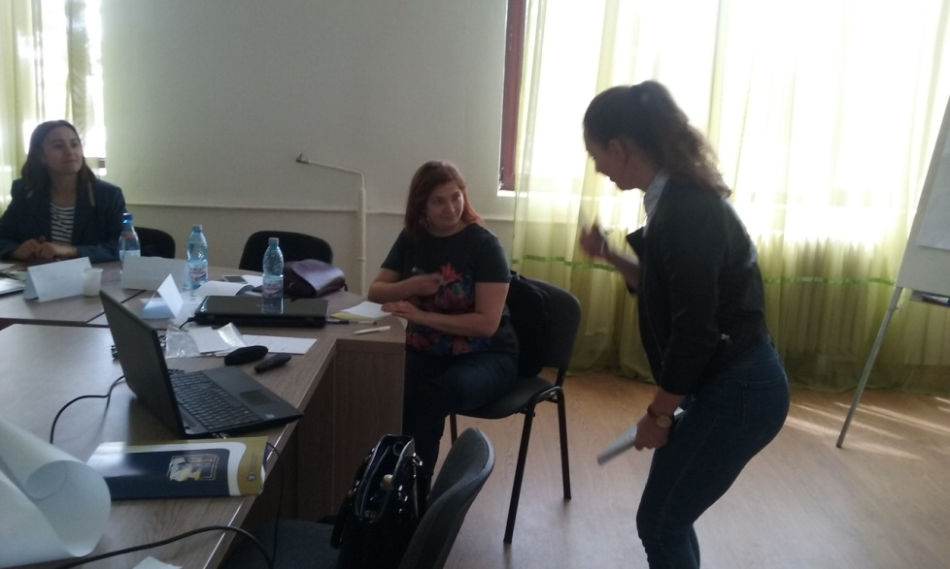
Training module

Slide 26

The training module evaluation
The training module content
The training module was met my expectations a rate of…%:
53% responded with 100%, 47% between 70-90%
02. It was was easy to understand..%:
53% responded with 100%, 47% different
03. The novelty degree was…%:
20% responded by 100%, 33% answered between 60% and 90%, 47% between 20% and 50%
04. I believe that is practical benefits represent...%:
43% responded with 100%, 25% between 60% and 90%, 35% under 60%

Slide 27
b) The training module proceedings
 | Completely agree | Rather agree | Neutral | Rather disagree | Disagree
The trainers succeded in getting my attention | 90% | 10% | - | - | -
The interactivity in session 1 was at a high level | 89% | 11% | - | - | -
The interactivity in session 2 was at a high level | 100% | - | - | - | -
The presentations caught my attention | 81% | 19% | - | - | -
My energy level was the same during the training due to sufficient breaks | 73% | 22% | - | 4% | 1%
The used methods have helped me to understand the topic of dyslexia better | 70% | 21% | - | 6% | 3%

Slide 28
c)Aspects related to the book entitled “Theoretical and Practical-applicative Orientations Regarding Educational Intervention on the Dyslexic Child” :
 | Completely agree | Rather agree | Neutral | Rather disagree | Disagree
The book has an attractive design | 75% | 14% | 11% | - | -
The book has pedagogical utility | 85% | 15% | - | - | -
The book has a clear content | 78% | 23% | - | - | -

Slide 29
d) Suggestions for improving the seminar’s quality
How can we cover a larger target group (parents)
A larger number of such seminars for teachers who come from different fields
Adding therapy elements designed for dyslexia
Practical examples
Interactive activities

Slide 30
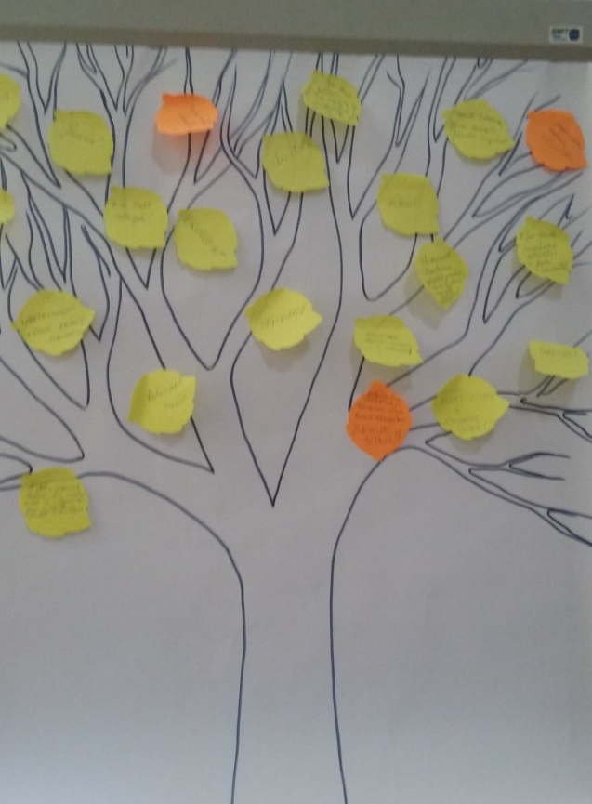
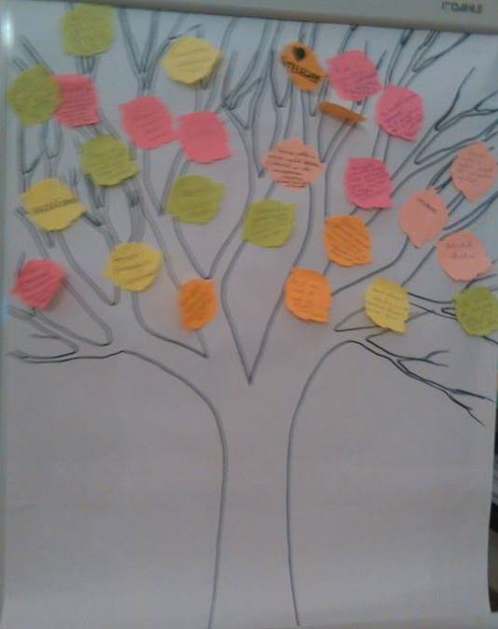
Evaluation „tree”

Slide 31


