Slide 1

Strategic partnership
''Hidden Stars''
2014-2016

Slide 2
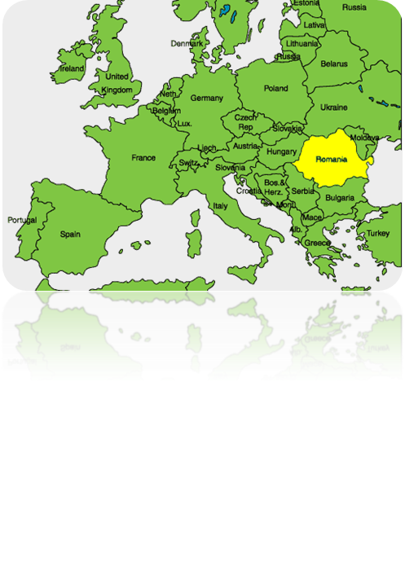

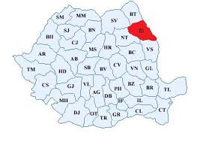

Slide 3
Iasi – symbolical space of culture and civilization

Slide 4
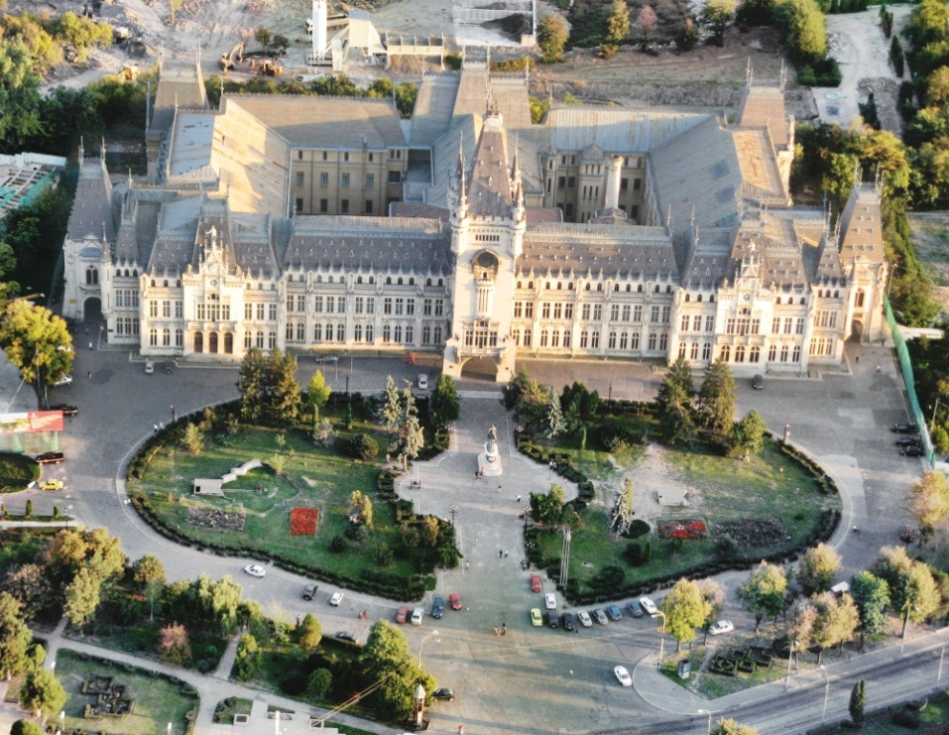
The Palace of Culture

Slide 5
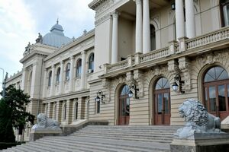
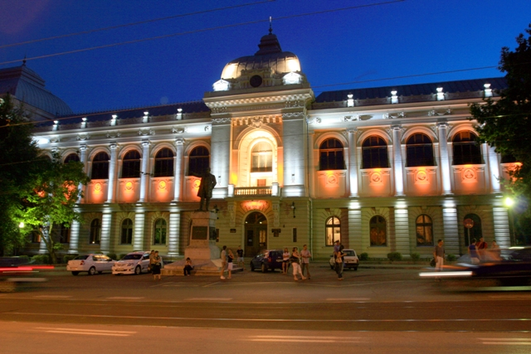
“AL. I. CUZA” UNIVERSITY of IASI

Slide 6
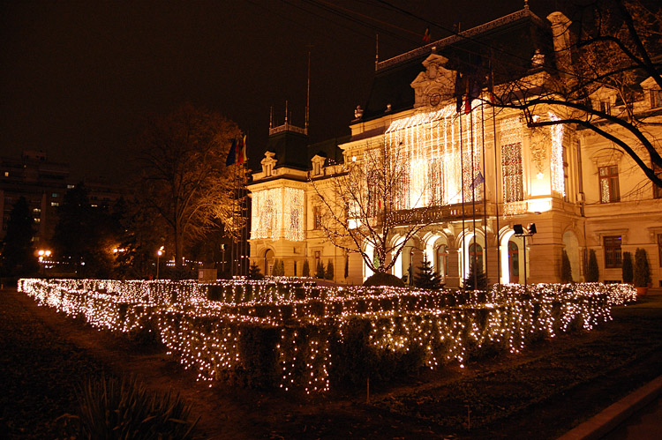
ROZNOVANU PALACE – THE CITY HALL OF IASi

Slide 7
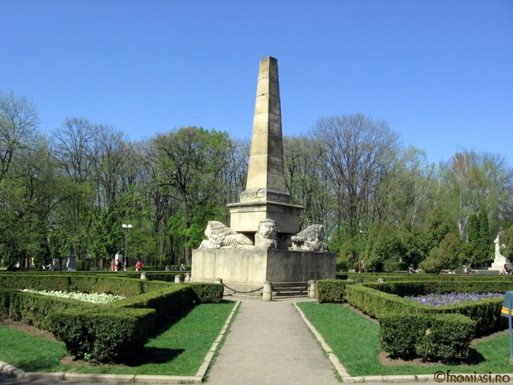
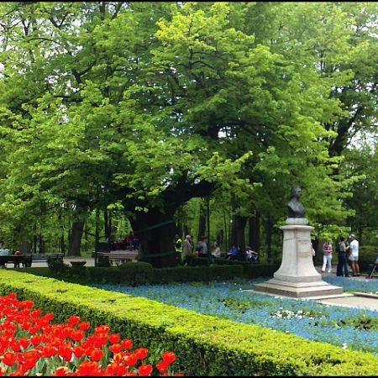
PARK OF COPOU

Slide 8
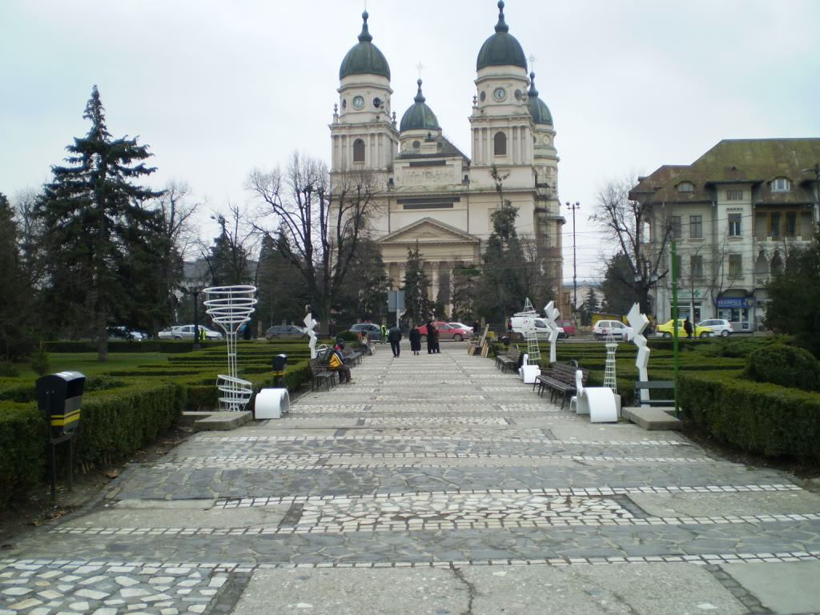
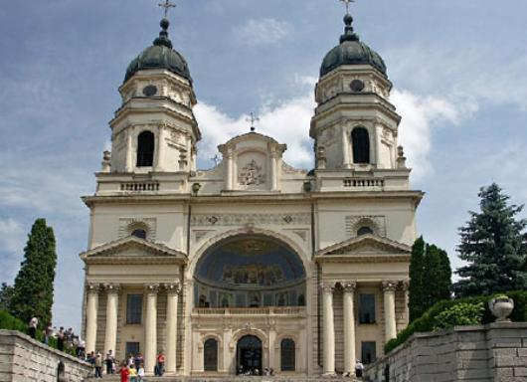
THE ORTHODOX CATHEDRAL

Slide 9
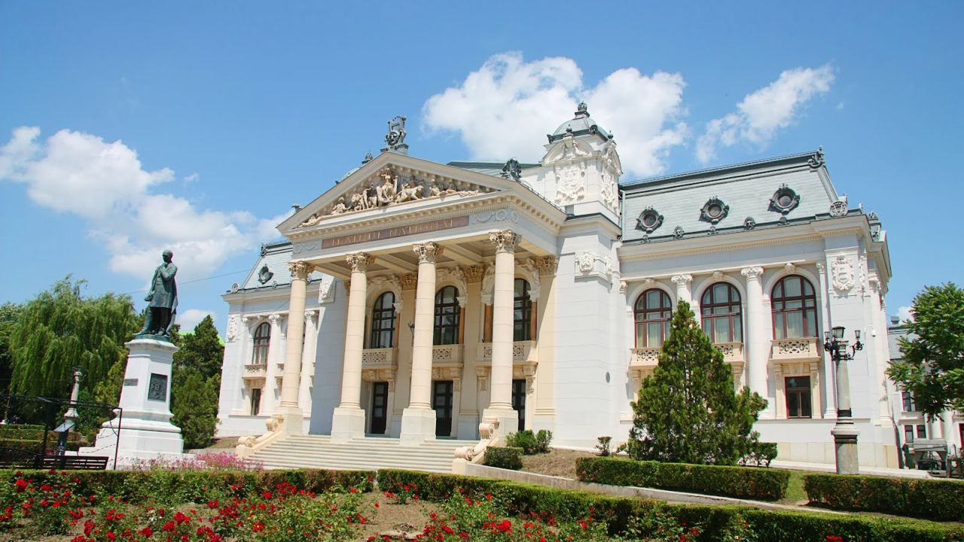
“VASILE ALECSANDRI” NATIONAL THEATRE

Slide 10
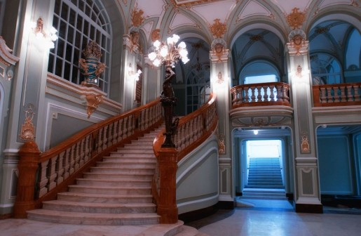
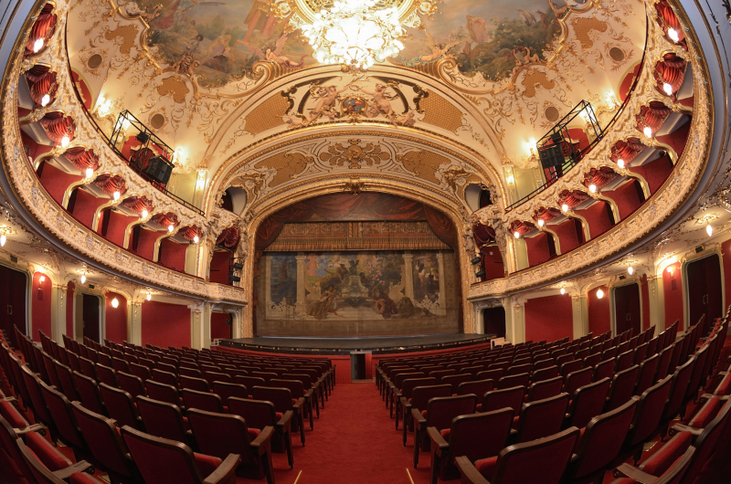
“VASILE ALECSANDRI” NATIONAL THEATRE - INTERIOR

Slide 11
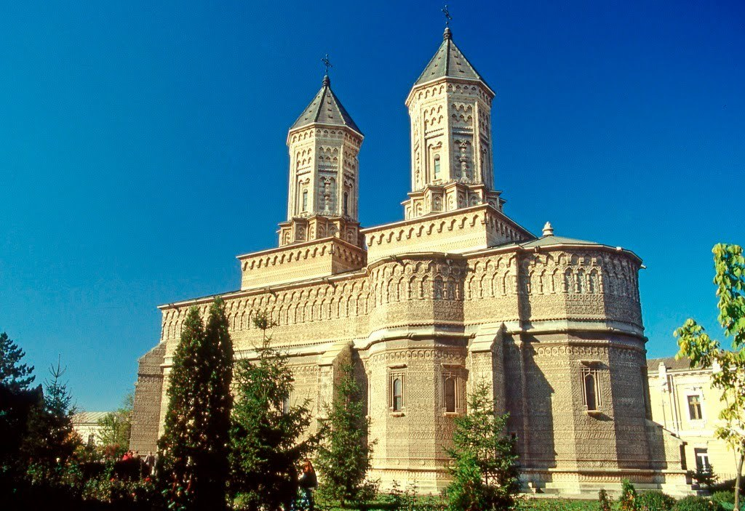
Monastery of the Three Hierarchs

Slide 12
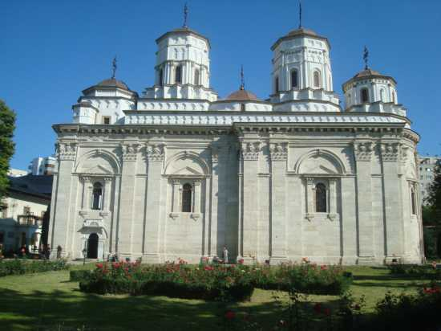
Golia monastery

Slide 13
School inspectorate of Iasi: public body that provides professional guidance, coordination and evaluation for schools and training centres in order to ensure high-quality education services, continuous improvement and effectiveness of the national/local education system and its compatibility with the European system

Slide 14
The County of Iasi in numbers
more than 700000 persons
135 000 STUDENTS ENROLLED IN PUBLIC SCHOOLS (MORE THAN A HALF in the urban area)
232 schools (preschool, primary, secondary level): 105 in urban area, 127 in rural area
more than 3000 STUDENTS in private schools
more than 9000 teachers

Slide 15
Types of schools/educational services
Theoretical schools/high schools (realistic, humanistic)
Vocational schools/high-schools (arts, physical education, religion, pedagogy)
Professional schools/high-schools (technological and economical)
Special schools
Psychological counseling: psychologists and psycho-pedagogists

Slide 16
17-18 May 2016, Iasi: the multiplier events
The final conference
The training modules for 100 teachers

Slide 17
The final Regional Conference
“Theoretical and practical-applicative approaches regarding educational intervention for dyslexic/learning - communication difficulties child”
  17.05.2016, Iasi
a) In figures:
  120 teachers from primary and preprimary schools
  2 special guests from Faculty of Psychology as speakers
  7 school principals
  10 school inspectors
  3 representatives from NGOs

Slide 18

b) In itelectual outputs
Realized together by:
  Turkey:
    1. Basic Academic Skills
    2. Basic Social Skills
  Romania:
    1. Basic Psychomotor Skills
    2. Family and teacher support system

Slide 19
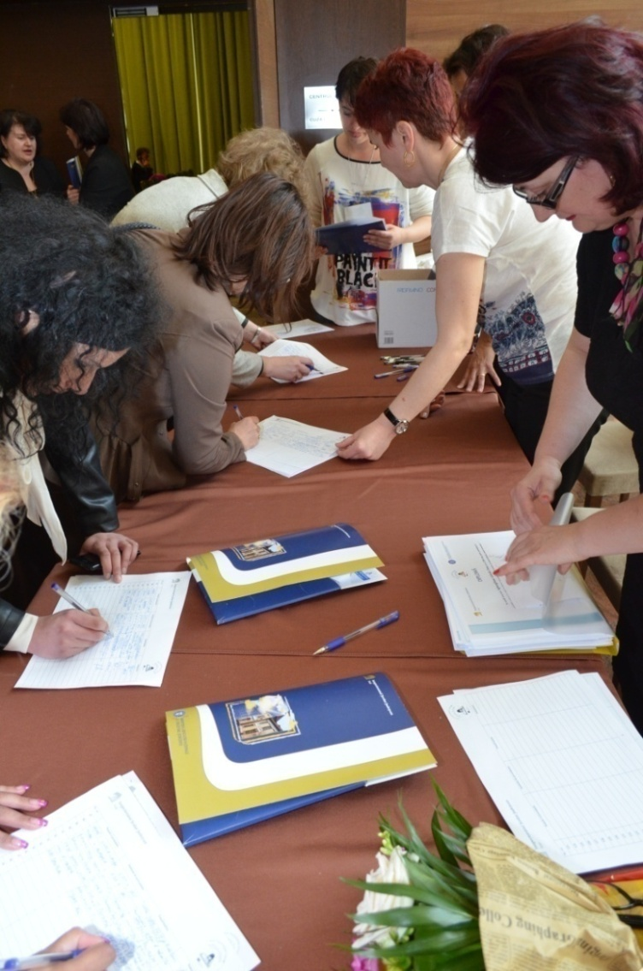
c) In images…
Participants registration

Slide 20
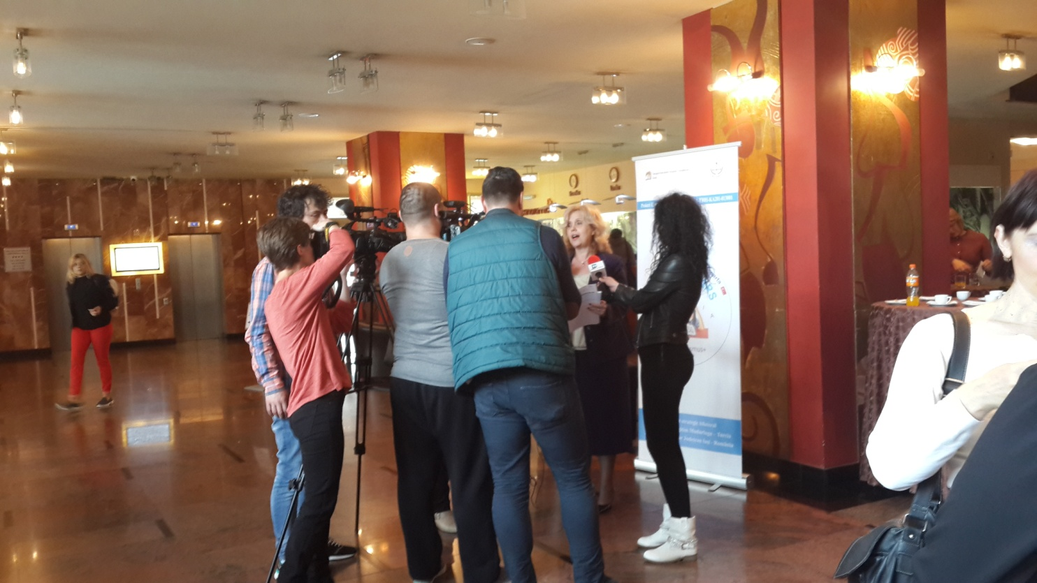
In dialog with the regional mass media

Slide 21
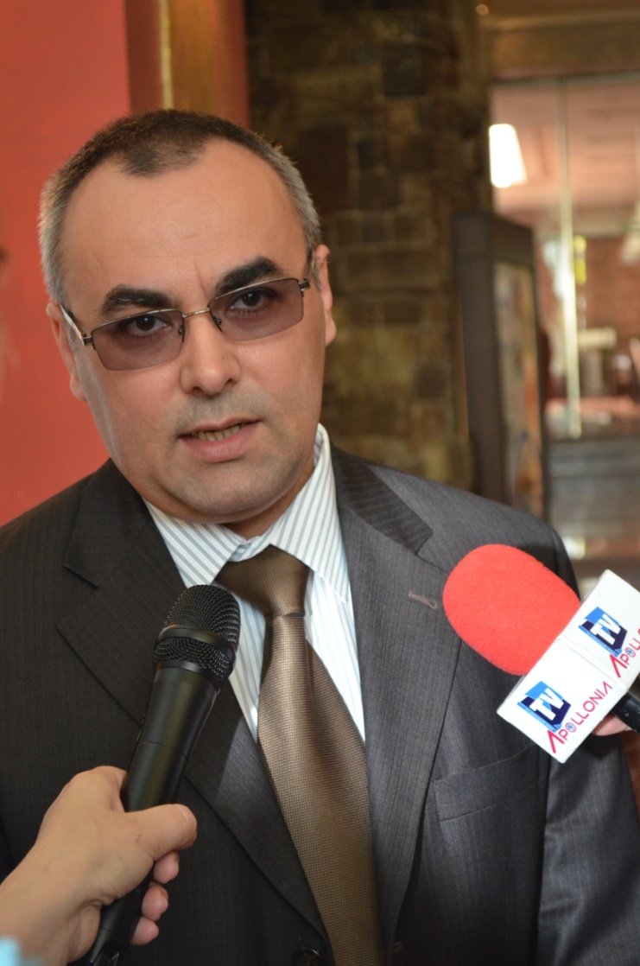
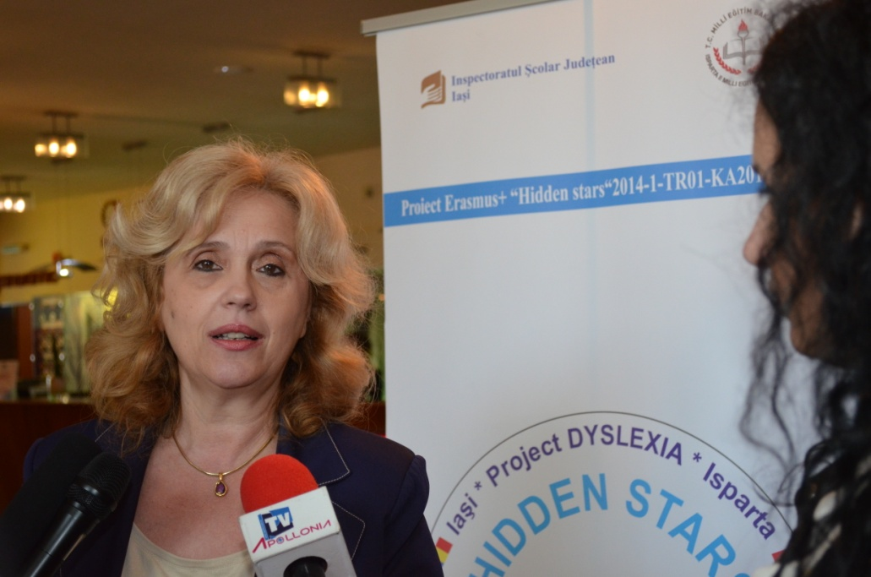
With regional mass media

Slide 22
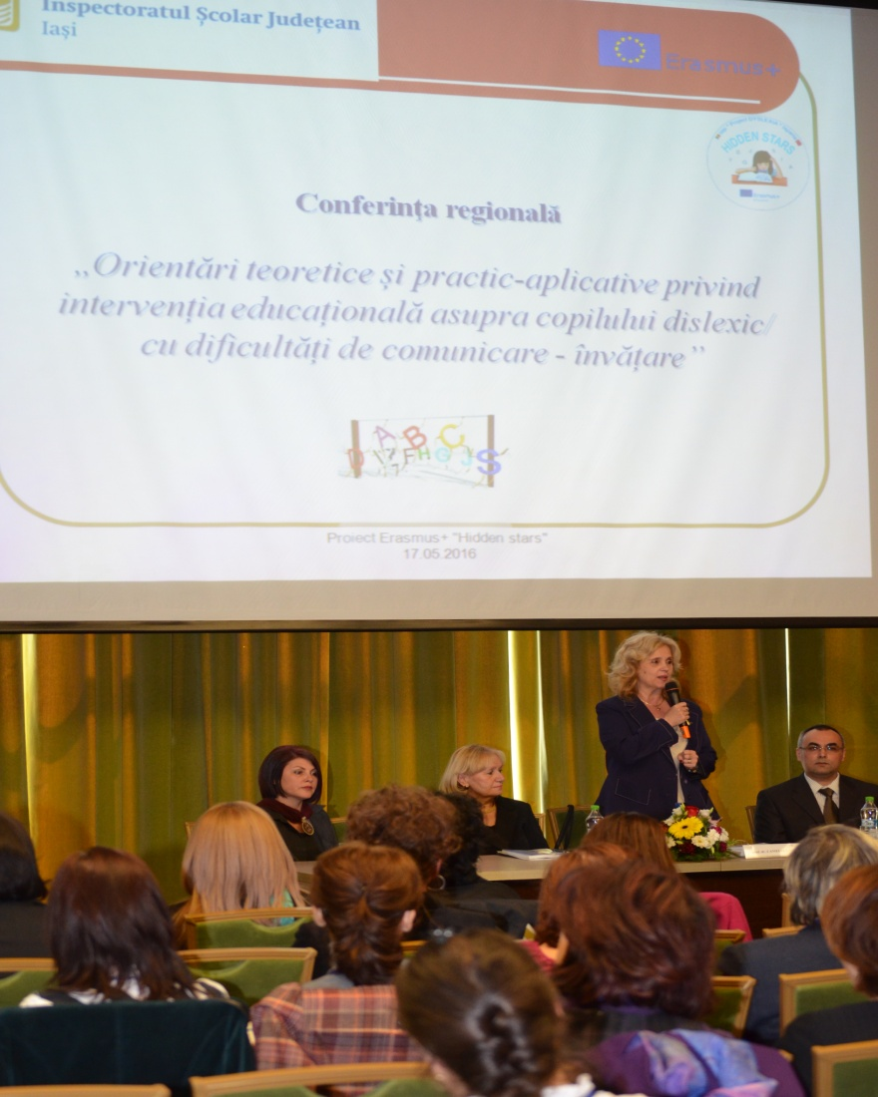
Conference opening: “Thinking, language, communication - paths and stages of a complex education “
Phd Teacher Camelia Gavrilă – General School Inspector - ISJ Iași

Slide 23
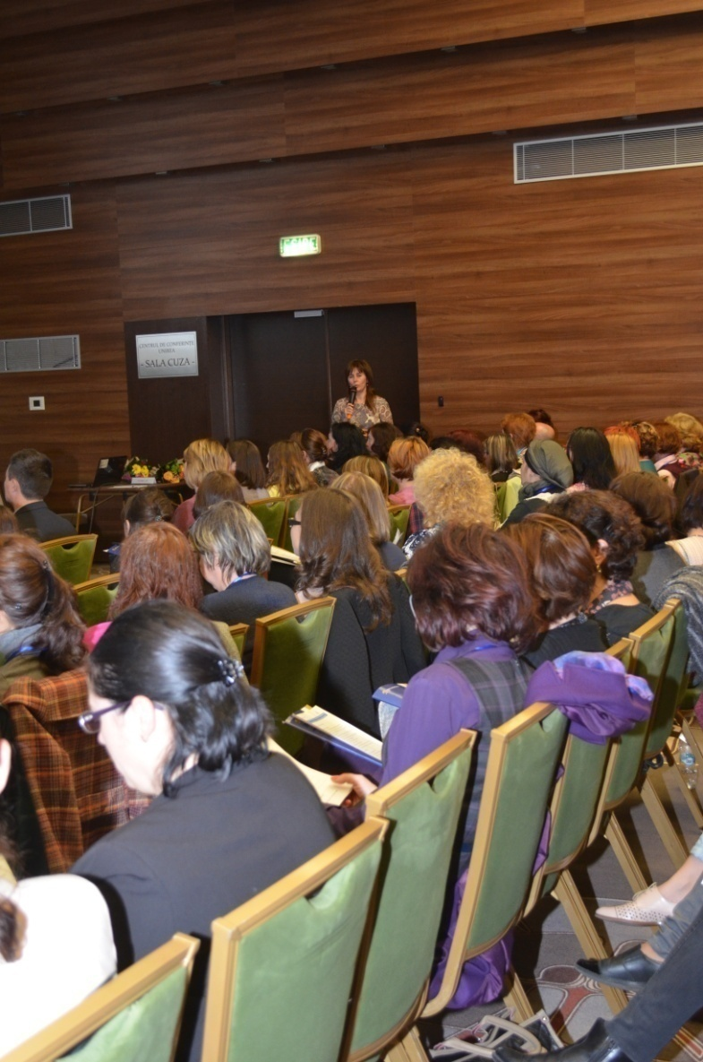
“Hidden stars”- Erasmus Project presentation
Gabriela Conea - School inspector for educational projects ISJ Iasi

Slide 24
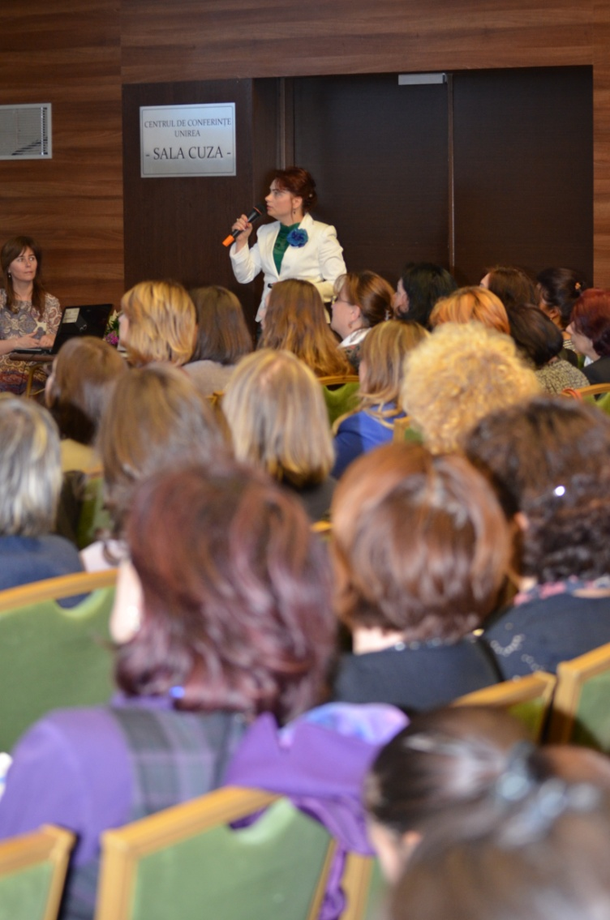
Education for communication. New challenges and educational solutions.
Phd teacher Genoveva Farcaş- School inspector for primary education - ISJ Iași

Slide 25
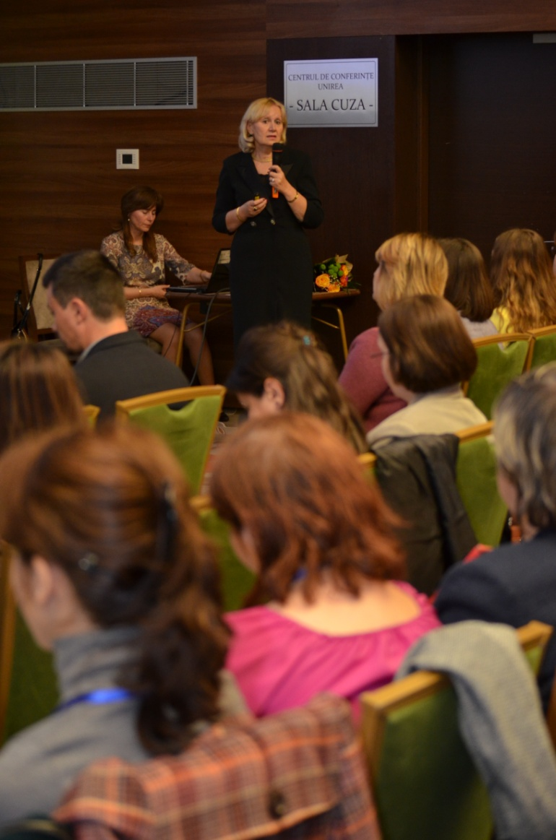
Dyslexia – academic perspective , viewpoints
Phd Professor Iolanda Tobolcea - "Alexandru Ioan Cuza“ University, Iasi

Slide 26
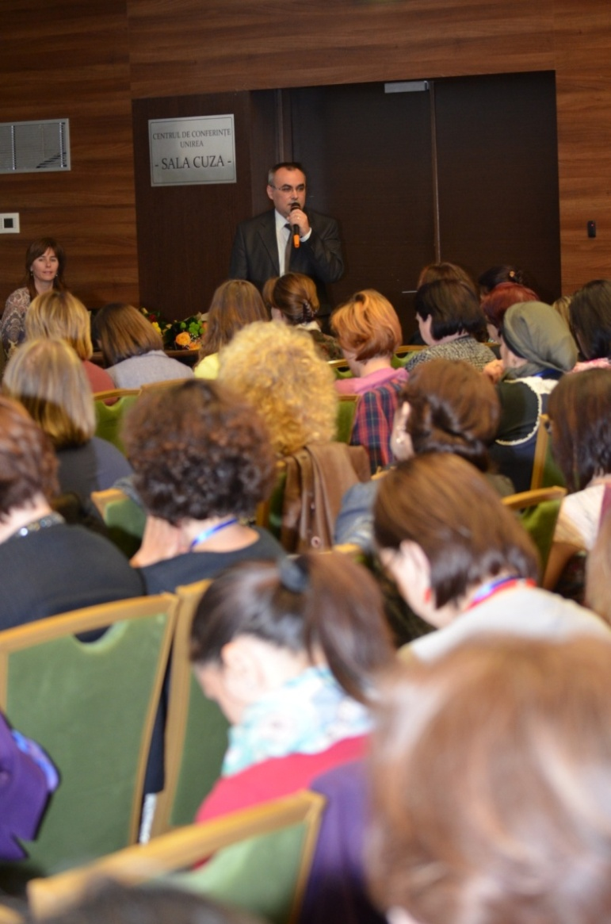
Dyslexia – academic perspective , viewpoints
Phd. Professor Florin Frumos - "Alexandru Ioan Cuza" University, Iasi

Slide 27
Interventions of the participants:
”Redefinition of dyslexia therapy in terms of results of research in neuroscience ", speech therapist -Teodora Purle, CLI Iaşi
Case study– speech therapist Chilcoş Mihaela, DGASPC/CT ”Ion Holban"
Project intellectual output presentation – the book „Theoretical and practical-applicative approaches regarding educational intervention for dyslexic child / communication difficulties – learning”
  Scientific review: Gabriela Raus- Inspector school for special education
  Insights into the scientific content: speech therapists Chirilă Livia, Alina Mendelovici
The role of the interdisciplinary team in therapeutic intervention for children with communication difficulties - Aura Tabara, school inspector for human resource development

Slide 28

The conference evaluation
The conference content
The conference was raised my expectations a rate of…%:
70% responded with 100%, 30% between 80-95%
02. It was understandable in the proportion of ..%:
81% responded with 100%, 19% different
03. The novelty rate was…%:
23% responded by 100%, 44% answered between 60% and 90%, 33% between 20% and 50%
04. I believe that is practical benefits represent...%:
53% responded with 100%, 40% between 80% and 95%, 7% under 70%

Slide 29

The conference evaluation
The conference content
05. I would have liked to include the following topics:
  The teacher perspective on training of dyslexic student
  Tackling dyslexia in terms of teacher. What should initiate teacher in case of a dyslexic child
  Examples of good practice on educational intervention dyslexic child
  Use of information technologies in educational intervention dyslexic child
  Language disorders
  Practical exercises with dyslexic pupils
  Dyslexia in preschool children
  Methods for identifying dyslexia
  Limits and possibilities of therapy from the perspective of parents of children dislexo - dysgraphia

Slide 30
b) The conference proceedings
 | Completely agree | Rather agree | Neutral | Rather disagree | Disagree
The presentations were clear and well-structured | 90% | 10% | - | - | -
The material provided was useful and qualitative | 89% | 11% | - | - | -
The facilities offered to the venue, the event program, technical means were qualitative | 100% | - | - | - | -
The presentations caught my attention | 81% | 19% | - | - | -
My energy level has remained the same throughout the conference thanks to a sufficient number of breaks | 74% | 21% | - | 5% | -

Slide 31
c) The conference aspects:
Positive
The interest shown by participants
The presentations were clear and well-structured and caught my attention
Organization, seriousness, professionalism
Topical issue responds teachers needs
A very good informative volume
Techniques practical strategies on educational intervention dyslexic child
The practical guide
The updating information on learning disorders of children and the consequences of their development.
Receiving the presented materials
Collaboration between specialists
The presence of the personalities from academic level and their presentation
The practical examples related to the conference theme
The software for presenting dyslexia - very interesting
Negative: -

Slide 32
d) Suggestions for improving the quality of conference
Collaboration with school principals
More practical examples
The pragmatic aspects better highlighted

Slide 33
Conclusions
If all the butterflies in the world would join their flaps of wings could cause a hurricane that could change the planet ...(Butterfly Effect, 2004)
The topic was appreciated by the entire audience, theoreticians and practitioners of education for dyslexic children.
The final products of the project can be a guide which promotes educational best practices in the support for dyslexic children, educators and parents.
The representatives from the University have developed a series of educational intervention strategies using both traditional and modern, interactive, based on the use of ICT.
The conference underlined the importance of efficient inter-institutional partnership dyslexic child's education.
Practitioners involved in the project have brought into focus a number of case studies and news in education priority and metacognition neurolinguistic elements involved in the act of communication in the context of a dyslexic child's education.

Slide 34
Teşekkür ederim!

